Slide 1
RESTful Web Services
Instructor: Dr. Jagan Chidella
TA: Vamsi Krishna Myalapalli
Oracle Certified Expert JAVA Web Services Developer

Slide 2
REST Web Services
Pre Checks
1. JAVA 8
2. Eclipse EE Neon or higher
3. Post Man REST Client

Slide 3
Index
Website vs. Webservice
Standard Formats
JAX-RS vs. JAX-WS
URIs
Implementing GET, POST, PUT, DELETE
Returning XML and JSON Responses
Sending Status Codes and Resource Locations
HATEOAS
Visiting Jar, War, Ear
Deploying Services

Slide 4
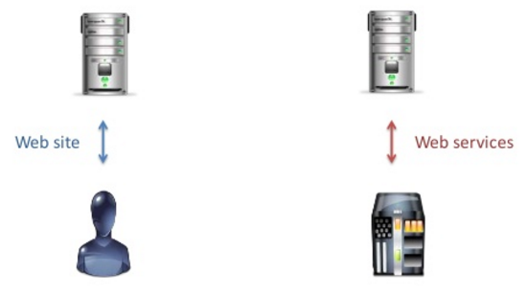
Website vs. Web Services
Human Consumption
Code Consumption
Notes:
A Web service is a web application component that uses standardized format like XML to interact with other web applications over internet. Whereas a website is a collection of webpages put together which are accessed by a web browser.

Slide 5
Standard Formats
JSON
XML
Java Script Object Notation
Extensible Markup Language
{
“name": "Agamemnon" ,
“war": "Trojan War“
}
<name>Agamemnon</name>
<war> Trojan War </war>
C
C++
JAVA
Python
.Net

Slide 6
Web Services
SOAP
REST
JAX-WS
JAX-RS
JAVA API for XML Web Services
JAVA API for RESTFul Web Services

Slide 7
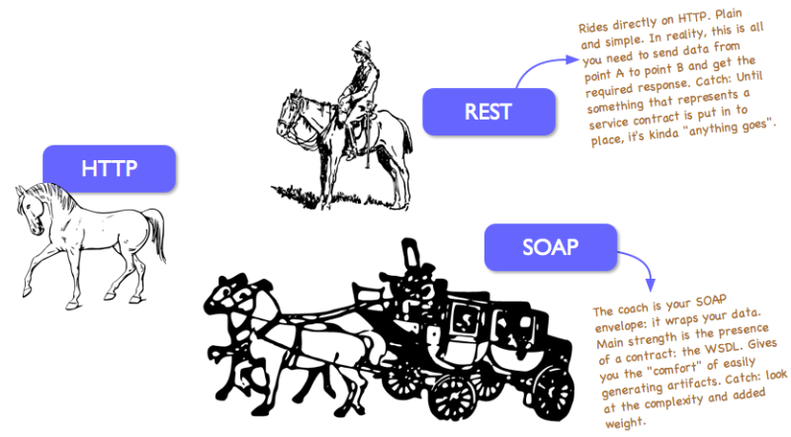
REST vs. SOAP

Slide 8
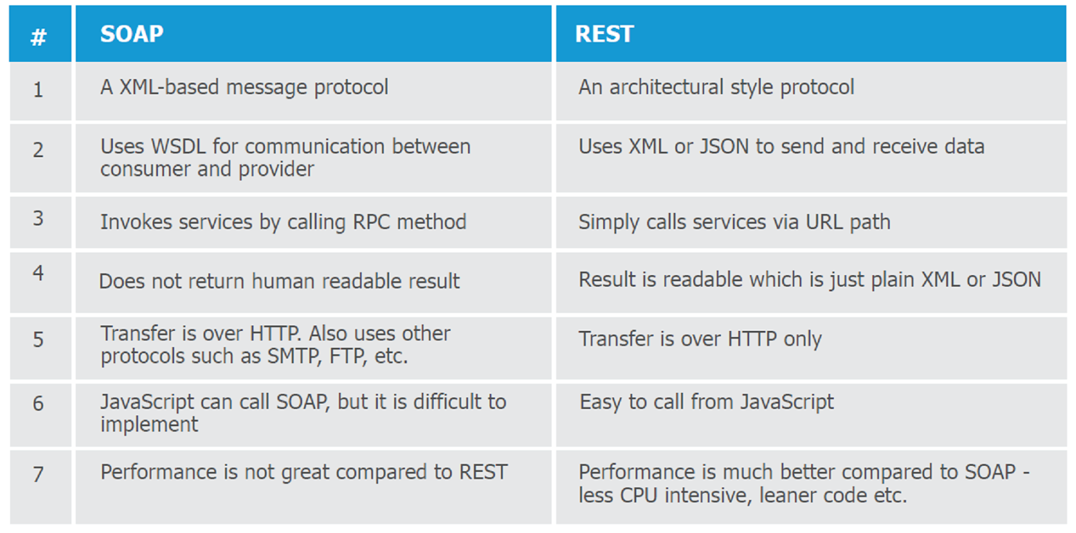
REST vs. SOAP

Slide 9
URI
Lookup/Action Based
Resource Based
Mysite.com/courses?course=1
Mysite.com/courses/course/1

Slide 10
RESTFul URIs
Instance Based
Collection Based
messages/1/comments/2
messages/1/comments
(List of Instance Resources)

Slide 11
JSON Response vs. XML Response
public class Student
{
private int id;
private String name;
}
JSON Response
XML Response
{
“id” : 76,
“name” : “Mr.Bean”
}
<Student>
<id> 76 </id>
<name> Mr.Bean </name>
</Student>

Slide 12
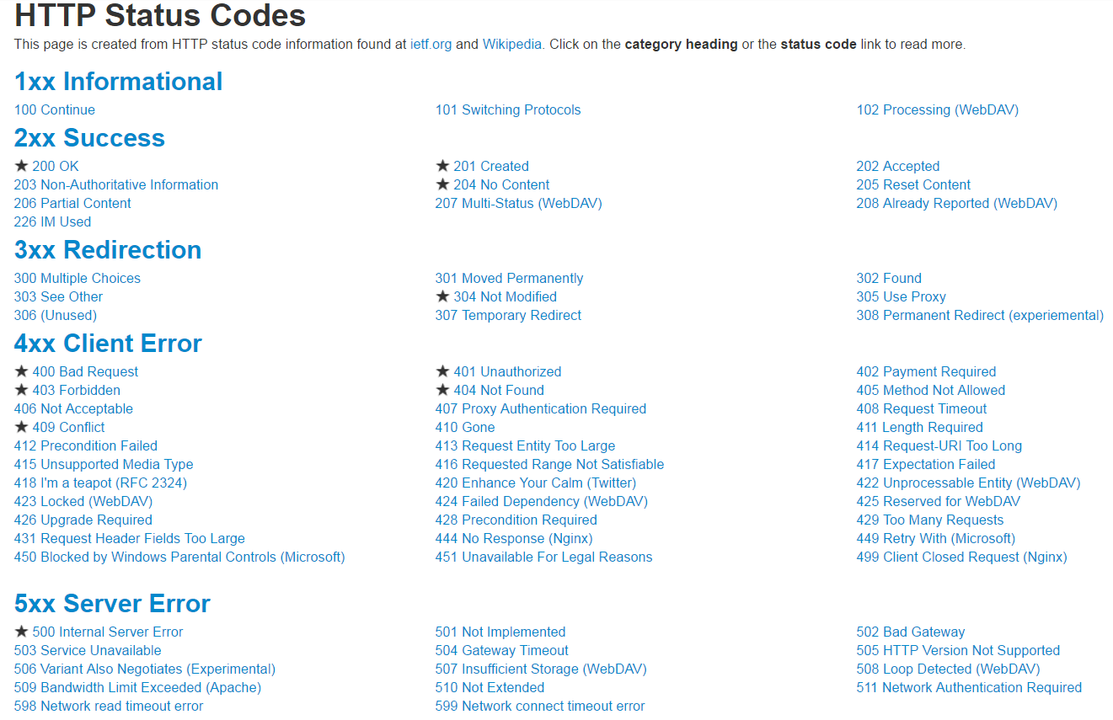

Slide 13
GET
Read
200
POST
Write + Read
HTTP Call
201
PUT
Write + Read
200
DELETE
Write
204

Slide 14
HATEOAS
Hypermedia as the Engine of Application State
Level 0 -> Not RESTFul API, Plain Old XML (POX) SOAP
<Message>
<id> 32 </id>
<mesg> Howdy </mesg>
</Message>
Level 1 -> Support Resource URI (Individual URI for each Resource)
messages/1/comments/2
Level 2 -> Support Status Codes and HTTP Methods (Get, Post, Post)
RESTFul
2xx, 4xx, 5xx
Level 3 -> Support Responses which contains that a Client can use
{
“id” : 1,
“mesg” : “Howdy”,
"links": [
{
"link": "http://localhost:8888/messenger/webapi/messages/1",
"rel": "self"
}
}

Slide 15
Jersey -> Provides API that extends JAX-RS to simplify RESTFul
-> Reference Implementation for JAX-RS specification
REST API Application
Jersey
JAX-RS Interfaces and Annotations
Application Code
Implementation Classes

Slide 16
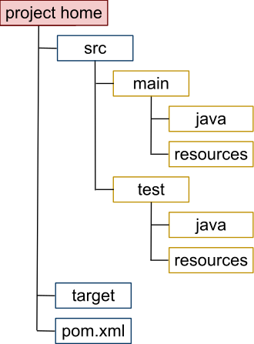
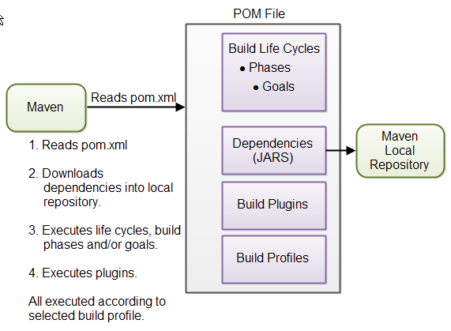
Maven -> Apache Maven is a project management tool.
Based on Project Object Model (POM).
Manages a project's build, reporting from a central piece of information.
pom.xml -> Project and configuration details used by Maven to build the project

Slide 17
@XmlRootElement
public class Warrior
{
String name, war;
}
// Default and Parameterized Constructors
// Getters and Setters
MessageBodyWriter
[
{
“name": "Agamemnon",
“war": "Trojan War“
},
{
“name": "Achilles",
“war": "Trojan War“
},
{ “name": "Hector",
“war": "Trojan War"
}
]
<warriors>
<warrior>
<name>Agamemnon</name>
<war>Trojan War</war>
</warrior>
<warrior>
<name>Achilles</name>
<war>Trojan War</war>
</warrior>
<warrior>
<name>Hector</name>
<war>Trojan War</war>
</warrior>
</warriors>

Slide 18
JAR vs. WAR vs. EAR
Class Files
JAR
Manifest File
Descriptor
JARs
WAR
Servlets
JSP
WARs
EAR
Beans
JARs

Slide 19
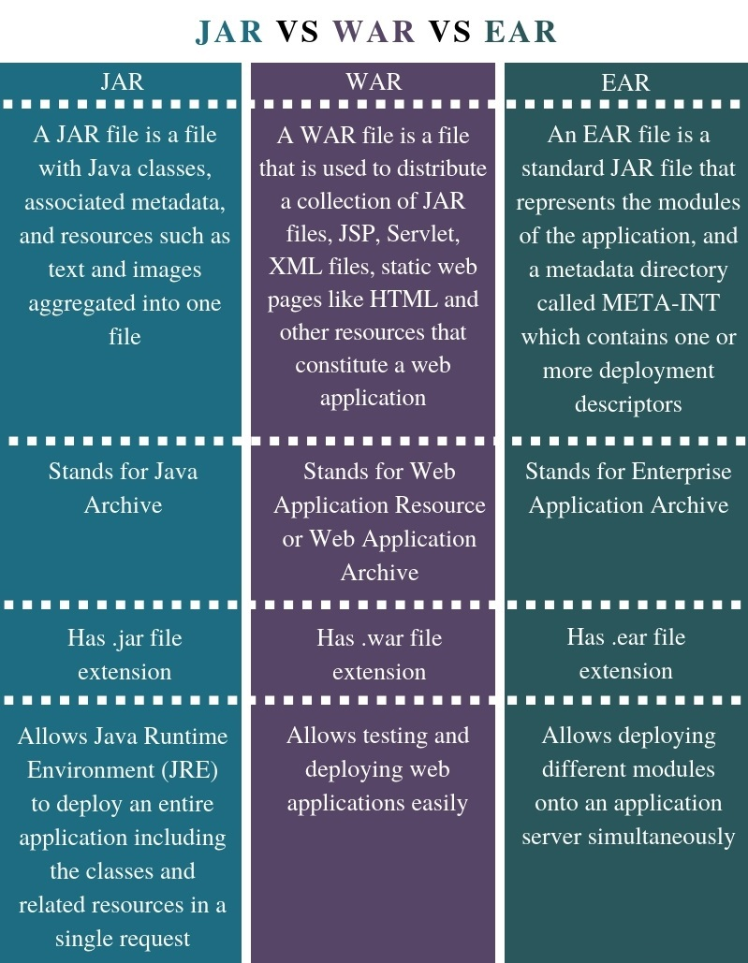
JAR vs. WAR vs. EAR

Slide 20
Queries

